Slide 1
MONGO-Db
Venugopal Shastri

Slide 2
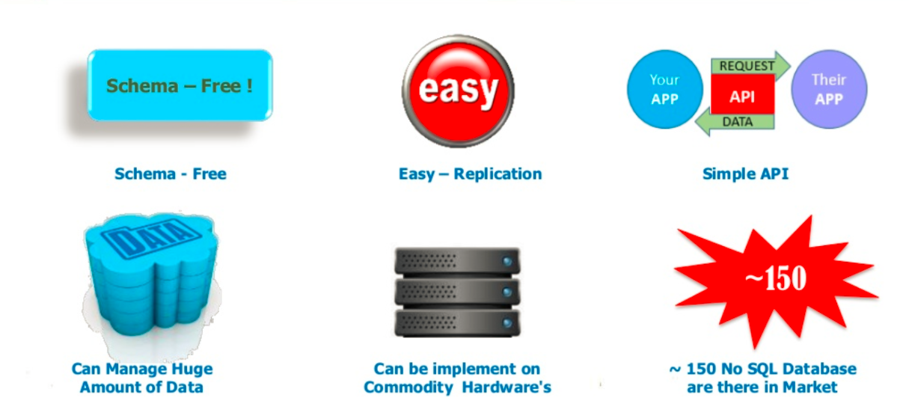
What is NoSql

Slide 3
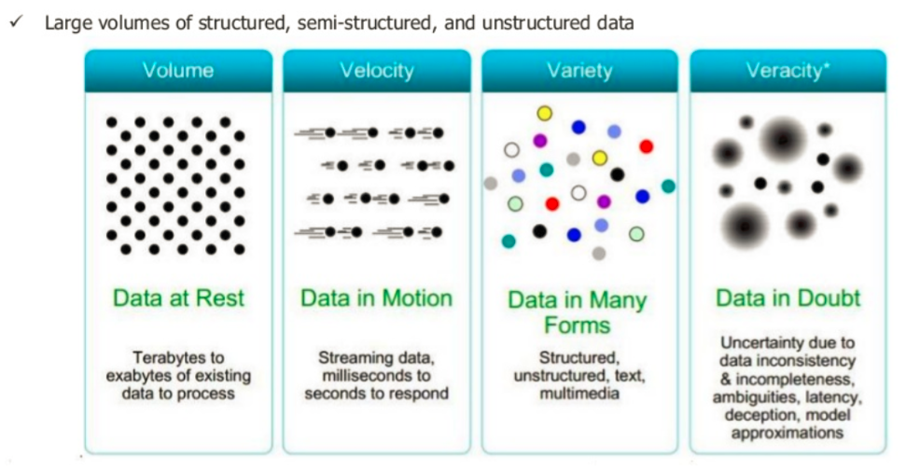
Benefits of NoSql

Slide 4
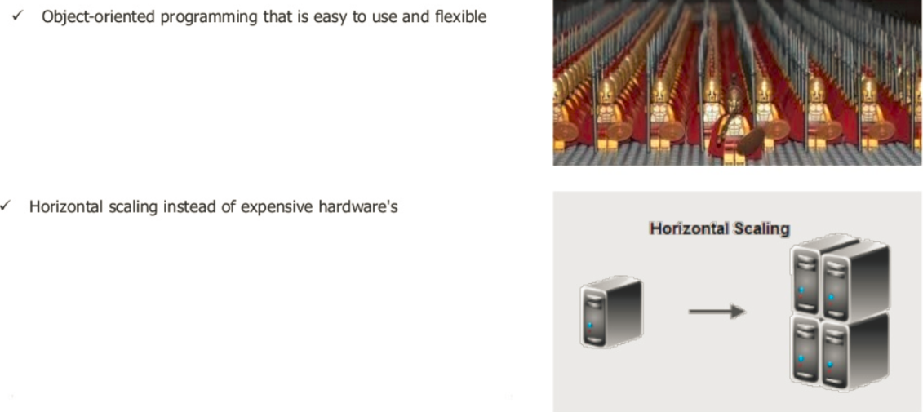

Slide 5
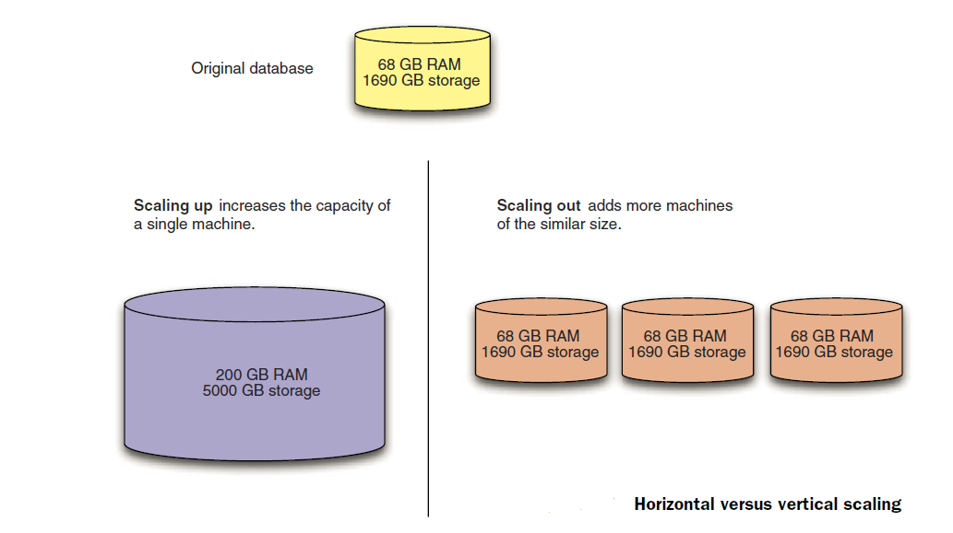

Slide 6
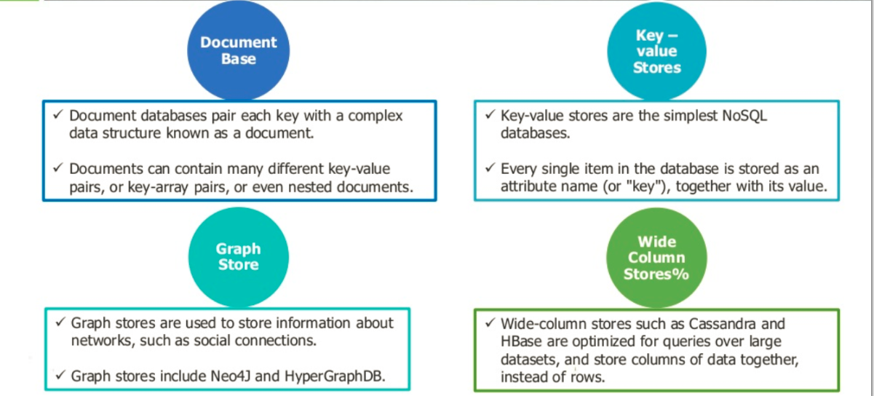
Categories of NoSql

Slide 7
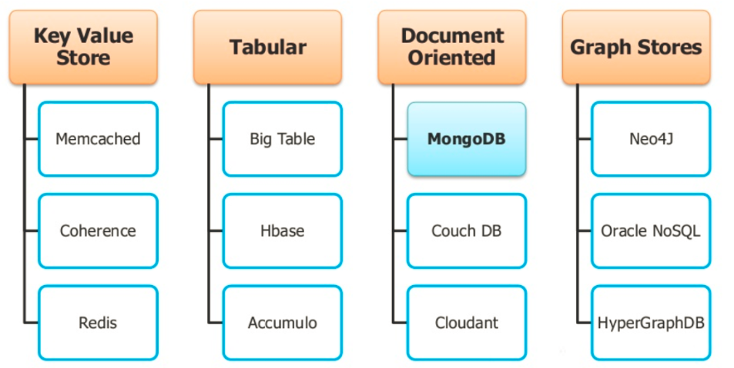
Types of NoSql

Slide 8
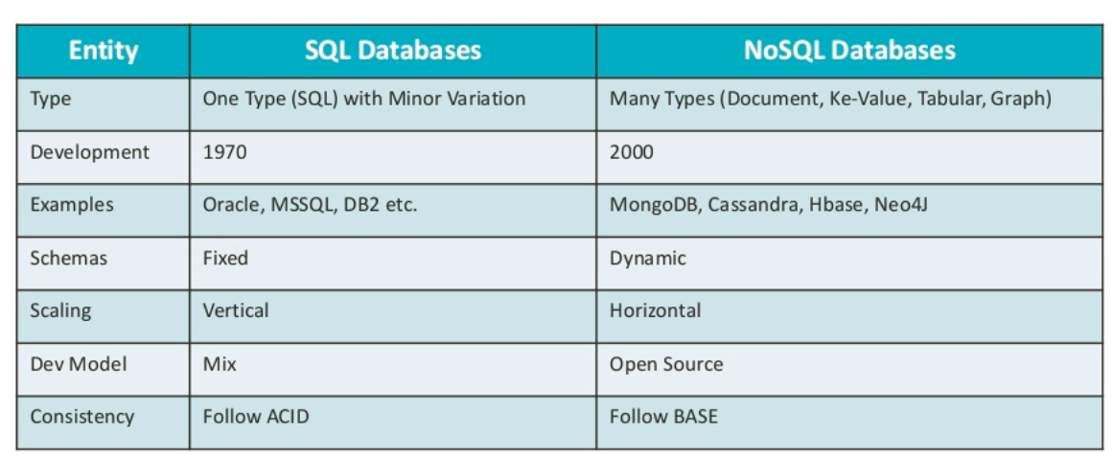
Comparison

Slide 9
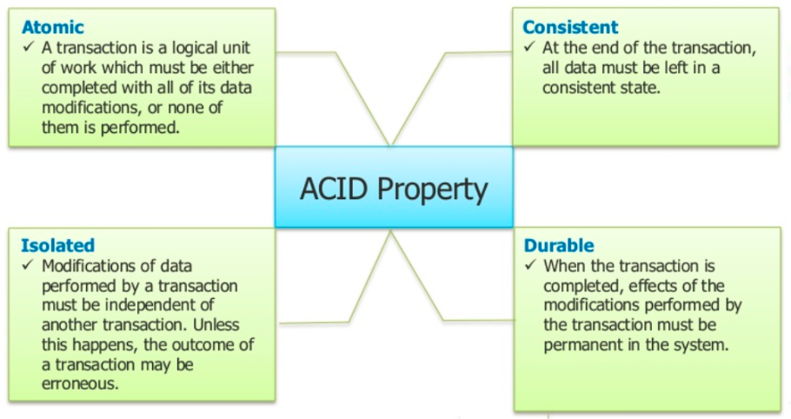
RDBMS (ACID)

Slide 10
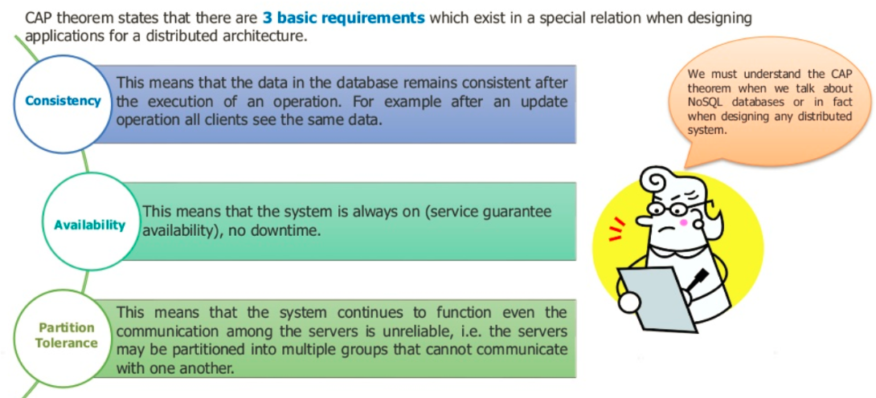
Cap Theorem

Slide 11
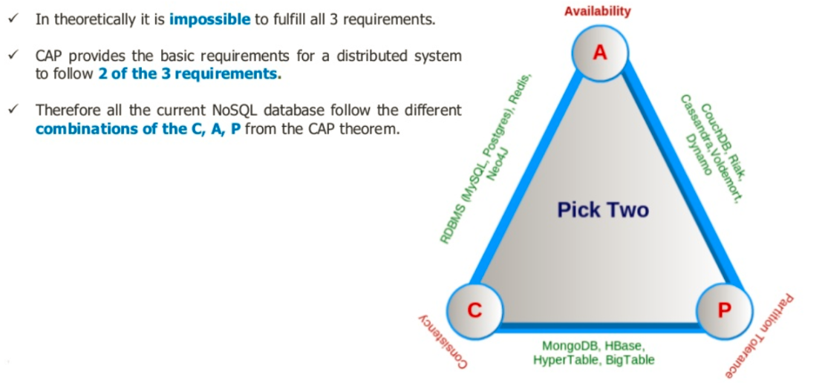
Cap

Slide 12
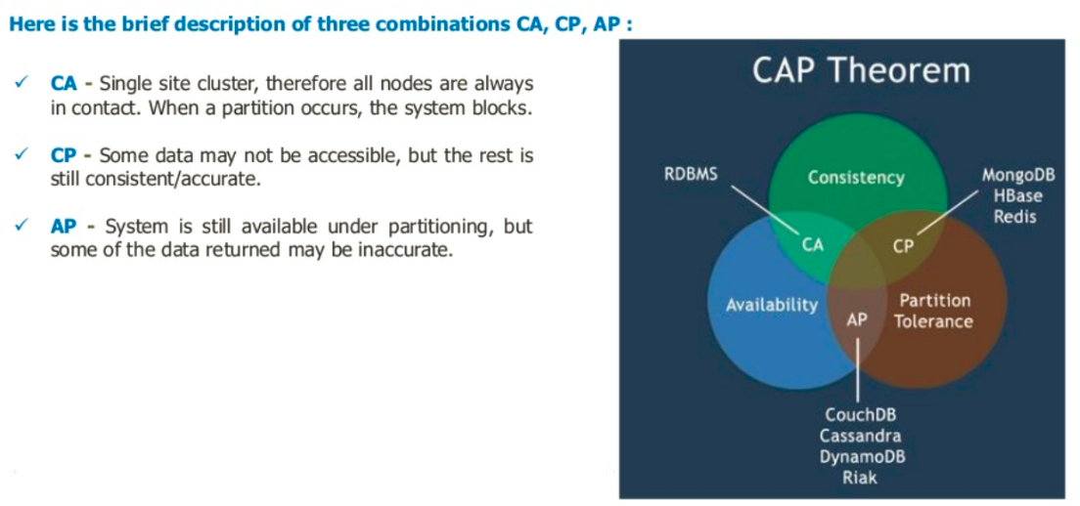
CAP

Slide 13
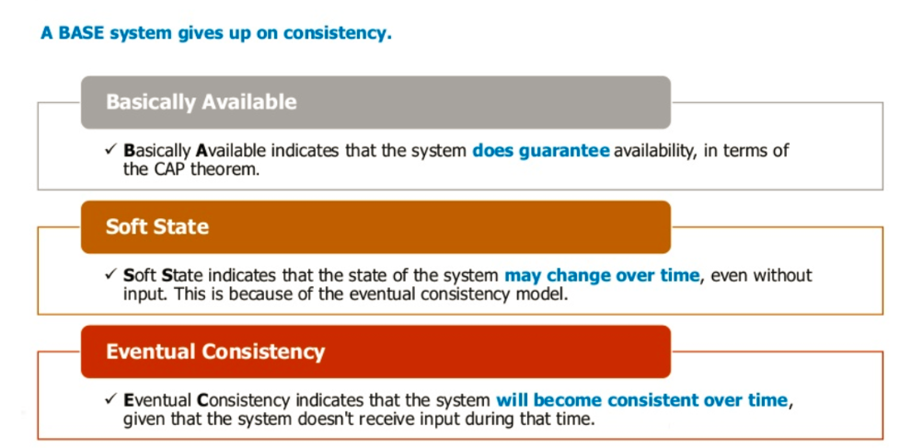
BASE

Slide 14
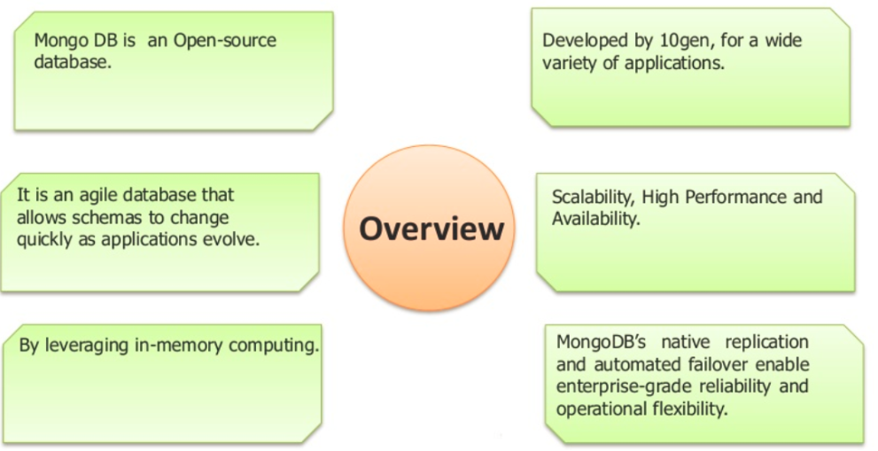
MongoDB Overview

Slide 15

Challenges

Slide 16
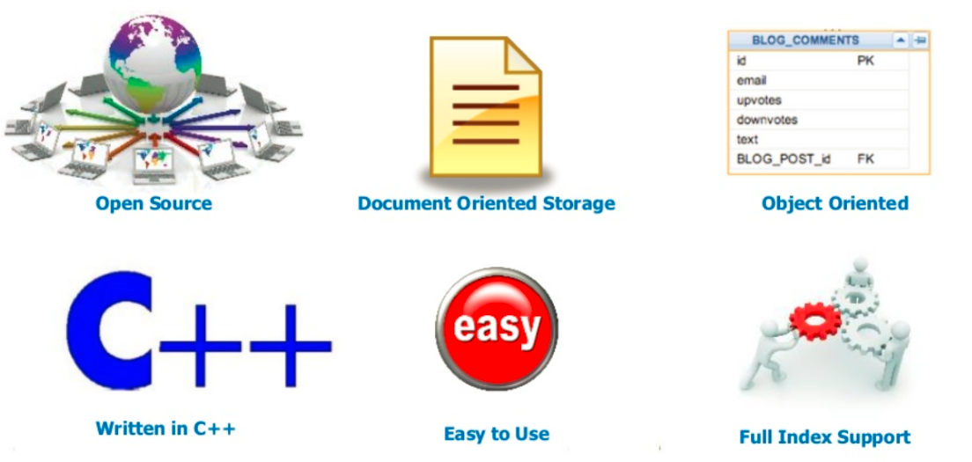
What is MongoDB

Slide 17
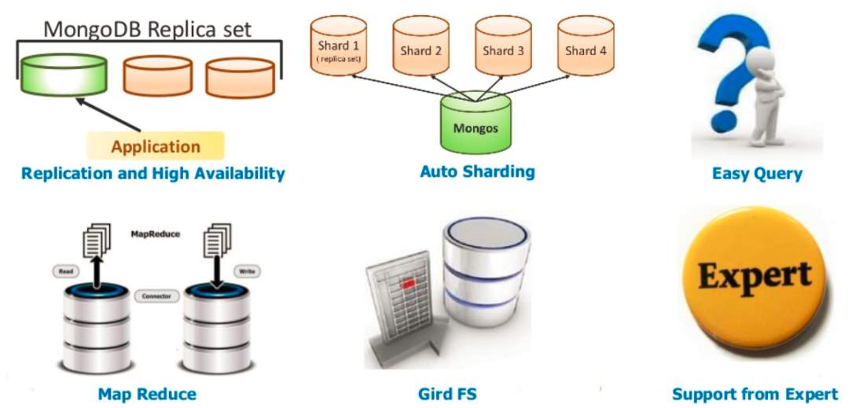
What is MongoDB ?

Slide 18
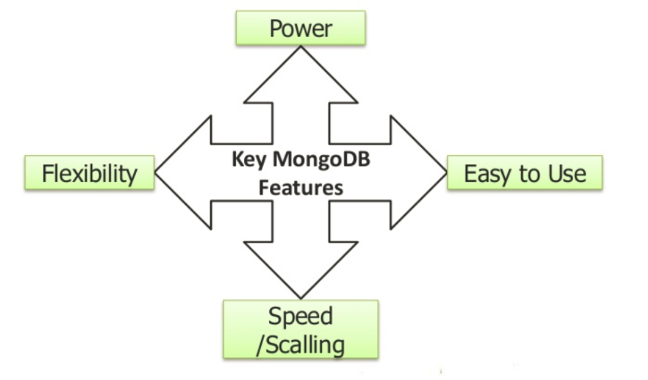
Key Features Of MongoDB

Slide 19

MongoDB Features

Slide 20
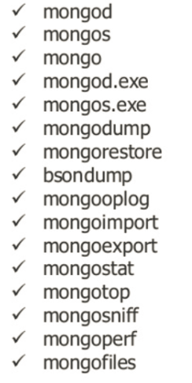
MongoDB Package Components

Slide 21
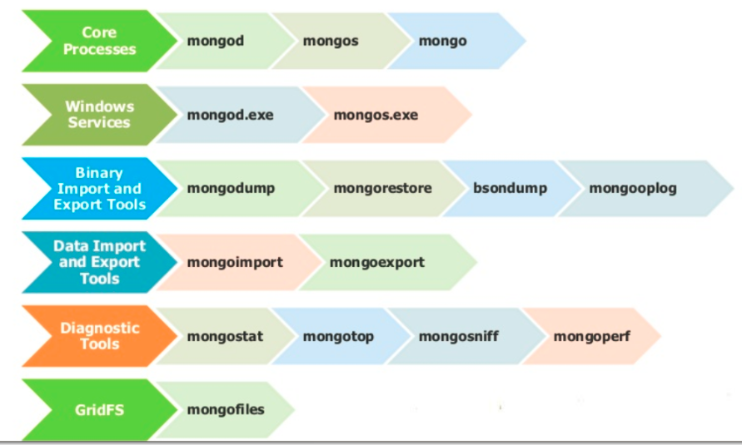
MongoDB Package Tools

Slide 22
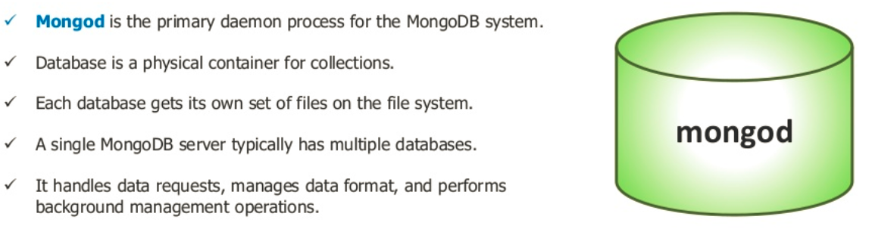
MongoDB

Slide 23
MongoDB Server
Running MongoDB as a standalone application
Installing MongoDB as a Windows service

Slide 24
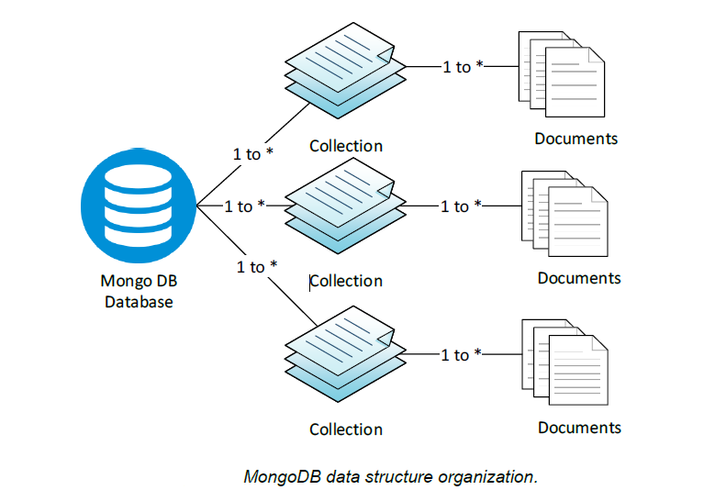
MongoDB Data Structure Org

Slide 25
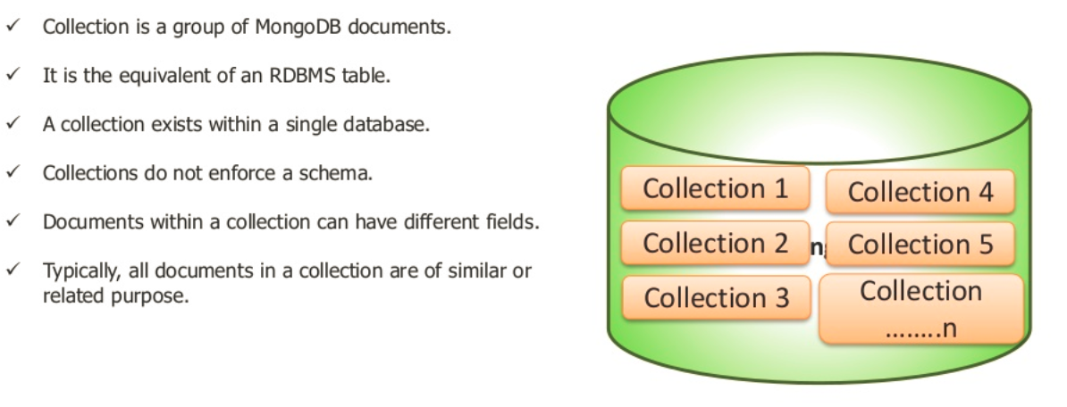
MongoDB Collection

Slide 26
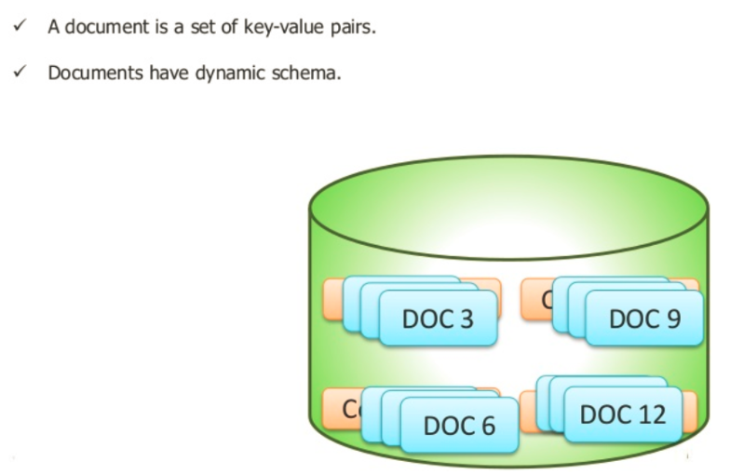
MongoDB Document

Slide 27
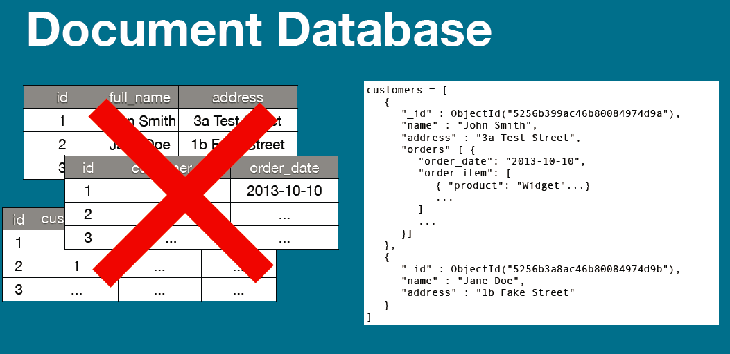
Document Database

Slide 28
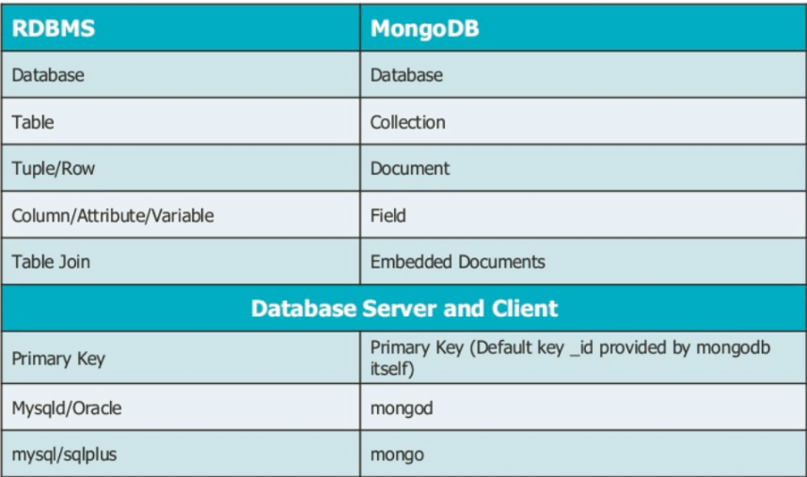
RDBMS Anology With MongoDB

Slide 29

JSON

Slide 30
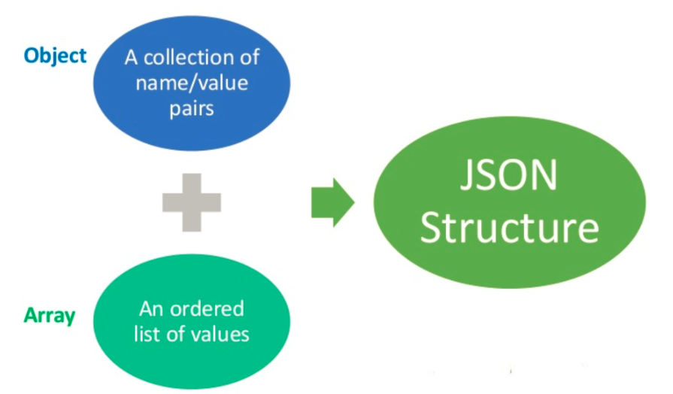
JSON

Slide 31
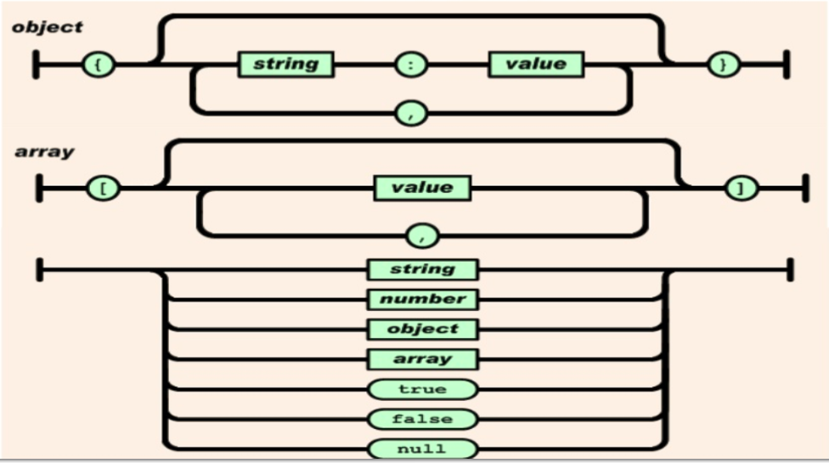

Slide 32
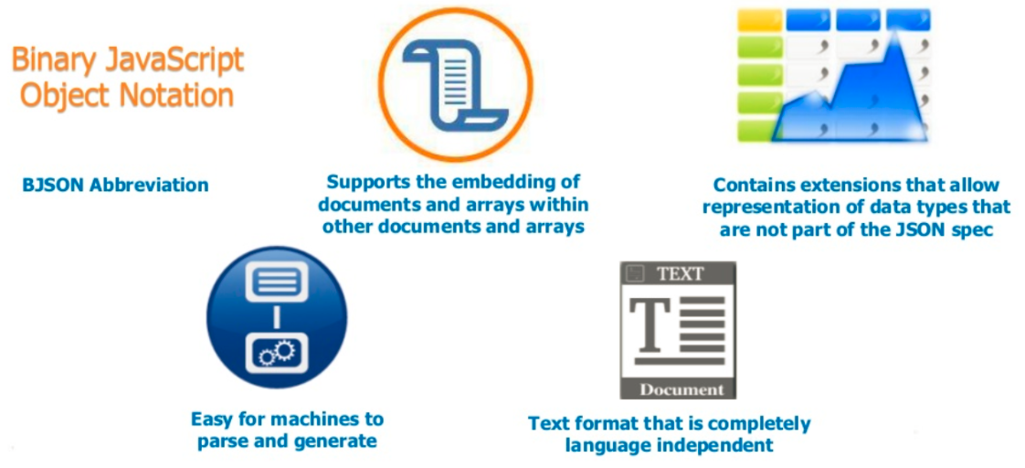
BSON

Slide 33
MongoDB through the -Mongo Shell
mongo.exe
An interactive JavaScript interface to the database
Used to query or manipulate data or perform administrative operations

Slide 34
MongoDB Storage Engine
MongoDB built-in engine: MMAPv1 engine
WiredTiger storage engine
more predictable performance than the related MMAP engine.
MongoDB engine (only enterprise edition)
The in-memory storage engine designed to serve ultra-high throughput
MongoRocks
MongoDB storage engine based on Facebook’s RocksDB-embedded database project.

Slide 35
Databases, collections, and documents
> use testdb
switched to db tutorial
Inserts and queries
db.users.insert({username: “Venu"})
db.users.find()
db.users.count()
_ID FIELDS IN MONGODB
document’s primary key
Every MongoDB document requires an _id

Slide 36
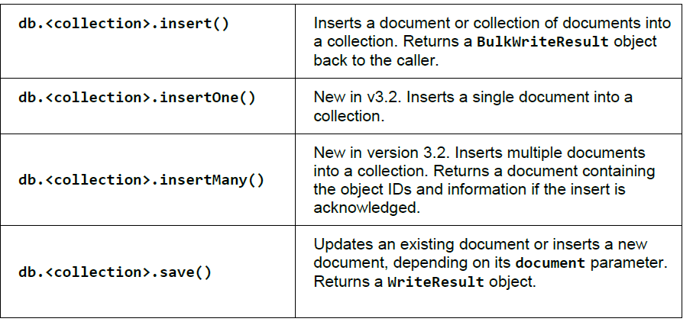
Inseting a Document

Slide 37
primary key
The ObjectId is a BSON type
12 bytes
4-byte value representing the seconds since the Unix epoch
3-byte machine identifier
2-byte process ID
3-byte counter, starting with a random value

Slide 38
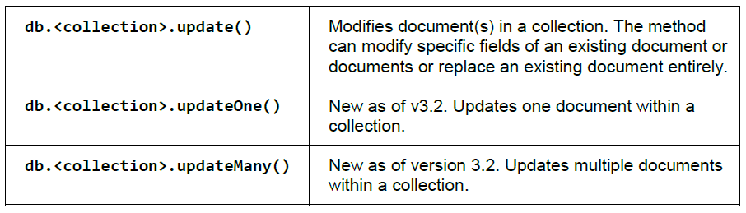
Update Documents
Update the value of an existing field.
Change the document by adding or removing attributes (fields).
Replace the document entirely.

Slide 39
Updating documents
Update()
Two Arguments
which documents to update
how the selected documents should be modified
db.users.update({username: “venu"}, {$set: {country: “IND"}})
Deleting data
db.foo.remove()
db.users.remove({"favorites.cities": "Cheyenne"})
db.users.drop()

Slide 40
PASS A QUERY PREDICATE
db.users.find({username: “Venu"})
db.users.find({
... _id: ObjectId("552e458158cd52bcb257c324"),
... username: “Venu“
... })
… indicates that the command takes more than one line

Slide 41
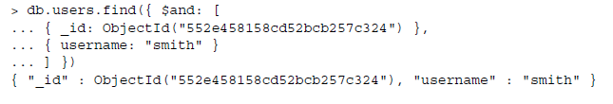
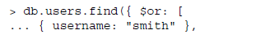
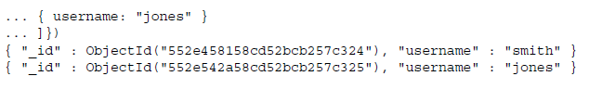
AND – OR Operation

Slide 42
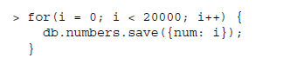
Creating and querying with indexes

Slide 43
"cursor" : "BasicCursor",
"isMultiKey" : false,
"n" : 4,
"nscannedObjects" : 20000,
"nscanned" : 20000,
"nscannedObjectsAllPlans" : 20000,
"nscannedAllPlans" : 20000,
"scanAndOrder" : false,
"indexOnly" : false,
"nYields" : 156,
"nChunkSkips" : 0,
"millis" : 8,
"allPlans" : [
{
"cursor" : "BasicCursor",
"isMultiKey" : false,
"n" : 4,
"nscannedObjects" : 20000
"nscanned" : 20000,
"scanAndOrder" : false,
"indexOnly" : false,
"nChunkSkips" : 0
}
"cursor" : "BtreeCursor num_1",
"isMultiKey" : false,
"n" : 4,
"nscannedObjects" : 4,
"nscanned" : 4,
"nscannedObjectsAllPlans" : 4,
"nscannedAllPlans" : 4,
"scanAndOrder" : false,
"indexOnly" : false,
"nYields" : 0,
"nChunkSkips" : 0,
"millis" : 0,
"indexBounds" : {
"num" : [
[
19995,
Infinity
]
]

Slide 44
Collections
Collections are containers for structurally or conceptually similar documents
db.createCollection("users")
db.createCollection("users", {size: 20000})
db.products.renameCollection("store_products")
Standard Collections
Capped Collections
TTL COLLECTIONS

Slide 45
Capped Collection
fixed-size, circular collections
Fixed-size refers to the fact that there is a predefined (configurable) limit on the maximum number of items this table will support.
Circular refers to the fact that once the maximum amount is reached, the oldest of the items gets deleted to make room to the new one.
collection itself preserves the order in which the items get inserted
we cannot remove a document or Update Document

Slide 46
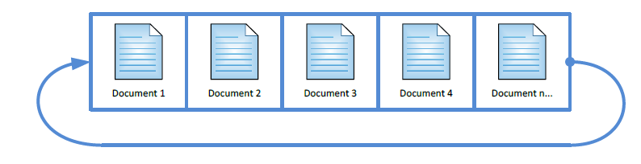
Capped Collection Usage
Logging (for example, the latest activity performed on the website).
Caching (preserving the latest items).
Acting as a queue: Capped collection might be also used to act as a queue where the first-in-first-out logic applies.
Capped: True sets the type of the collection as capped (the default is false).
Size: Sets the maximum size in bytes for this particular collection.
Max: Specifies the maximum number of documents allowed for the given collection.

Slide 47
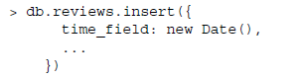
TTL Collection
Expire documents from a collection after a certain amount of time has passed
implemented using a special kind of index
TTL index on _id is not allowed
TTL indexes with capped collections are not allowed
Compound TTL indexes are not allowed

Slide 48
SYSTEM COLLECTIONS
system.namespaces
system.indexes

Slide 49
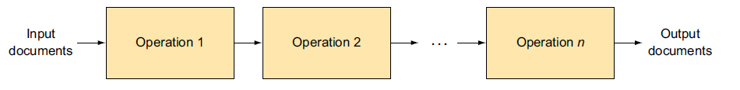
Aggregation framework is MongoDB’s
advanced query language
transform and combine data from multiple documents to generate new information
A call to the aggregation framework defines a pipeline

Slide 50
Aggregation Pipeline Operations
$project—Specify fields to be placed in the output document (projected).
$match—Select documents to be processed, similar to find().
$limit—Limit the number of documents to be passed to the next step.
$skip—Skip a specified number of documents.
$unwind—Expand an array, generating one output document for each array entry.
$group—Group documents by a specified key.
$sort—Sort documents.
$geoNear—Select documents near a geospatial location.
$out—Write the results of the pipeline to a collection (new in v2.6).
$redact—Control access to certain data (new in v2.6).

Slide 51
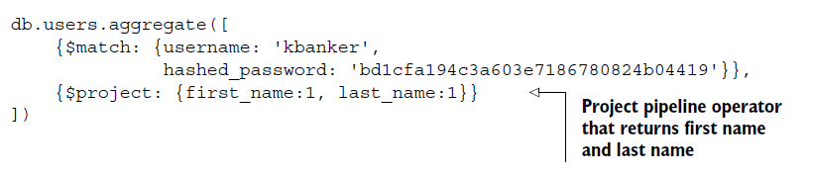
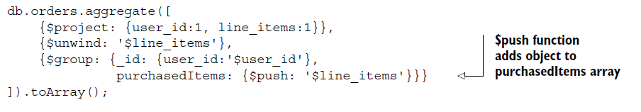
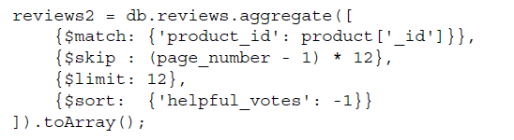

Slide 52
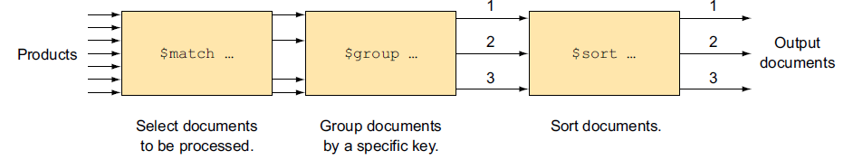
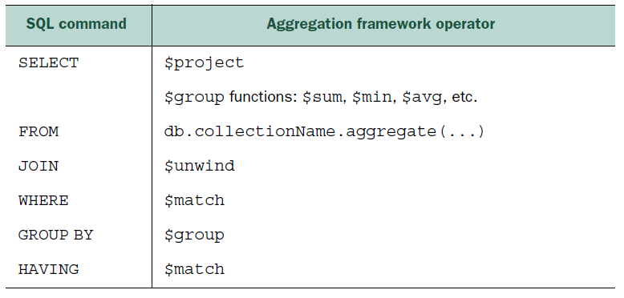
Example aggregation framework pipeline

Slide 53
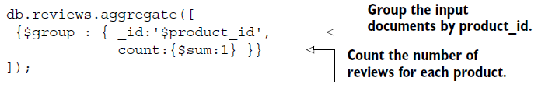
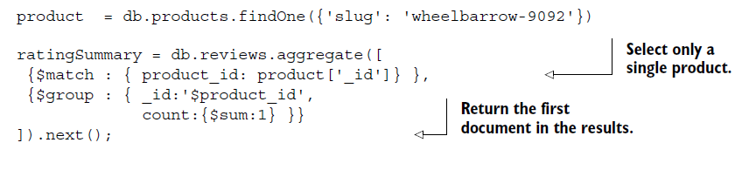
Examples

Slide 54
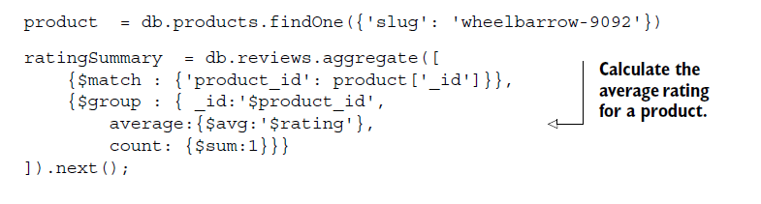
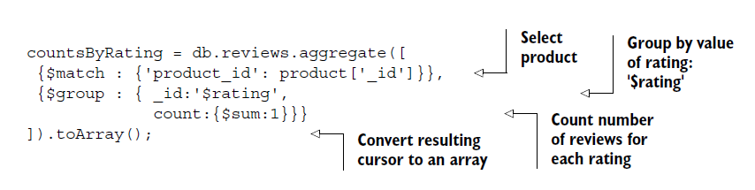
Examples

Slide 55
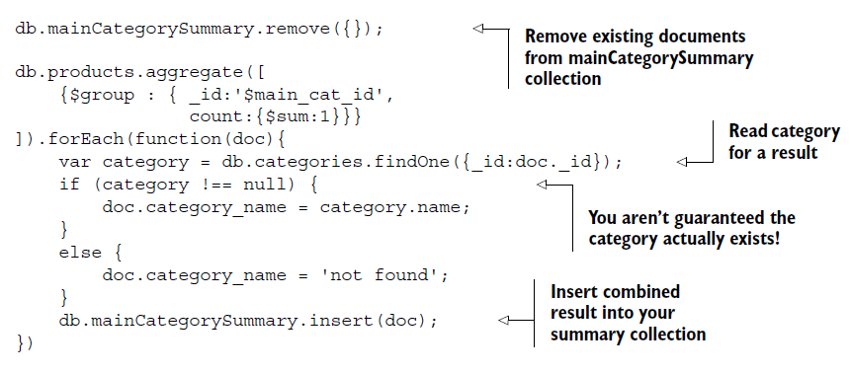
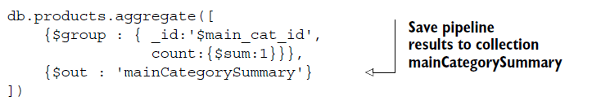

Slide 56
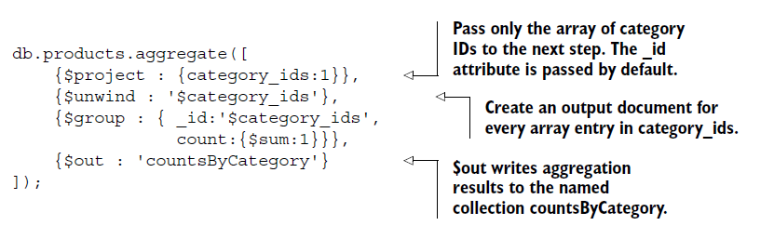
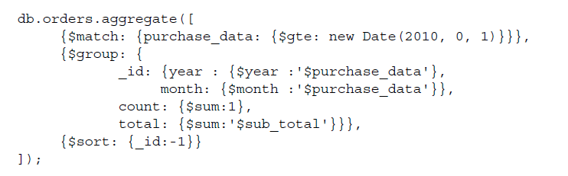

Slide 57
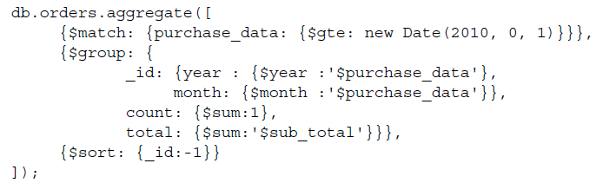
SUMMARIZING SALES BY YEAR AND MONTH

Slide 58




Slide 59






Slide 60
Aggregation pipeline options
db.collection.aggregate(pipeline,additionalOptions)
explain()—Runs the pipeline and returns only pipeline process details
allowDiskUse—Uses disk for intermediate results
cursor—Specifies initial batch size
{explain:true, allowDiskUse:true, cursor: {batchSize: n} }

Slide 61

Aggregation in C#
building the pipeline
Each operation in the pipeline will make modifications to the data: the operations can for example filter, group and project the data
pipeline is a collection of BsonDocument object
Each document represents one operation.

Slide 62

Aggregation by pre-filtering the data to be grouped

Slide 63
Understanding aggregation pipeline performance
Try to reduce the number and size of documents as early as possible in your pipeline.
Indexes can only be used by $match and $sort operations and can greatly speed up these operations.
You can’t use an index after your pipeline uses an operator other than $match or $sort.

Slide 64

Connecting to the database (C#)

Slide 65

Authentication

Slide 66

Referencing a database

Slide 67



Working with collections

Slide 68
BulkWrite
BulkWrite and BulkWriteAsync
Uses WriteModel
InsertOneModel
DeleteOneModel
DeleteManyModel
UpdateOneModel
UpdateManyModelModel
ReplaceOneModel

Slide 70

Object Mapping
Using CustomAttributes
BsonClassMap

Slide 71

Find (Query) Data in C#

Slide 72



FilterDefinitionBuilder

Slide 73


Slide 74

Projecting data
Return just a subset of data for a given query.
This is called a projection of data
Main entry point for the projections is the Builders object

Slide 75

Projection defined as strongly typed Object

Slide 76

Async version of the strongly typed projection definition

Slide 77
Binary Data (File Handling) in C#
GridFS is a MongoDB specification and a way of storing binary information larger than the maximum document size
GridFS It is kind of a file system to store files
GridFS divides a file into parts called chunks
Each chunk is a separate document
255 kilobytes of data.
When the file is downloaded (retrieved) from GridFS, the original content is reassembled.

Slide 78
GridFS
Two Built in Collections
Fs.files
store the file’s metadata
fs.chunks
Store the chunks
each chunk is identified by its unique _id
The fs.files acts as a parent document. The files_id assigned to a chunk holds a reference to its parent

Slide 79

GridFs

Slide 80
GridFs – C#
Use GridFSBucket in order to interact with the underlying GridFS system
Install the MongoDB.Driver.GridFS package from NuGet.
Install-Package MongoDB.Driver.GridFS -Version 2.5.0
Uploading files
specifying the location on the disk
submitting the data to a Stream object that the driver supplies.

Slide 81

Uploading File
>db.fs.files.find()
>db.fs.chunks.find()

Slide 82


Slide 83

Uploading files from a stream

Slide 84

Downloading files
Download as Byte Array
Receiving back a Stream object from the driver

Slide 85

DownloadAsBytes

Slide 86

DownloadBytes By Name

Slide 87

Download to a stream

Slide 88

Download to a stream By Name

Slide 89


Back Up and Restore

Slide 90
Indexing and Query Optimization
INDEXING RULES
Indexes significantly reduce the amount of work required to fetch documents.
Without the proper indexes, the only way to satisfy a query is to scan all documents linearly until the query conditions are met.
Only one single-key index will be used to resolve a query
if you have a compound index on a-b, then a second index on a alone will be redundant, but not one on b.
The order of keys in a compound index matters

Slide 91

Index Types
single-key index
Each entry in the index corresponds to a single value from each of the documents indexed.
COMPOUND-KEY INDEXES
query on more than one attribute
A compound index is a single index where each entry is composed of more than one key

Slide 92



As a general rule, a query where one term demands an exact match and another specifies a range requires a compound
index where the range key comes second

Slide 93
Indexing in MongoDb
UNIQUE INDEXES
Unique indexes enforce uniqueness across all their entries
db.users.createIndex({username: 1}, {unique: true})
Sparse Indexes
db.ensureIndex({"email" : 1}, {"unique" : true, "sparse" : true})
MULTIKEY INDEXES
db.values.createIndex({open: 1, close: 1})
DEFRAGMENTING
db.values.reIndex();

Slide 94
Sparse Indexes
unique indexes count null as a value
Collection cannot have a unique index with more than one document missing the key
How to enforce the unique index only if the key exists
Sparse indexes do not necessarily have to be unique
If you have a field that may or may not exist but must be unique when it does

Slide 95
USING THE PROFILER
db.setProfilingLevel(2)
db.setProfilingLevel(1, 50)
Profiling Results
stored in a special capped collection called system.profile
The system.profile collection is allocated 128 KB
db.system.profile.find({millis: {$gt: 150}})
db.system.profile.find().sort({$natural: -1}).limit(5).pretty()

Slide 96
Summary
Query optimization is always application-specific
Make a habit of profiling and explaining your queries
Indexes are incredibly useful but carry a cost—they make writes slower
MongoDB generally uses only one index in a query, so queries on multiple fields require compound indexes to be efficient
Order matters when you declare compound indexes

Slide 97
You should plan for, and avoid, expensive queries. Use MongoDB’s explain command, its expensive query logs, and its profiler to discover queries that should be optimized.
Optimize queries by reducing the number of documents scanned. The explain command is immensely useful for discovering what a query is doing; use it as a guide for optimization

Slide 98

Replication

Slide 99
Summary
We recommend that every production deployment of MongoDB where data protection is critical should use a replica set. Failing that, frequent backups are especially essential.
A replica set should include at least three members, though one of these can be an arbiter.
Data isn’t considered committed until it has been written to a majority of replica set members. In a failure scenario, if a majority of members remain they’ll continue to accept writes. Writes that haven’t reached a majority of members in this situation will be placed in the rollback data directory and must be handled manually.
If a replica set secondary is down for a period of time, and the changes made to the database don’t fit into MongoDB’s oplog, this node will be unable to catch up and must be resynced from scratch. To avoid this, try to minimize the downtime of your secondaries.
.

Slide 100
The driver’s write concern controls how many nodes must be written to before returning. Increase this value to increase durability. For real durability, we recommend you set it to a majority of members to avoid rollback scenarios, though his approach carries a latency cost.
MongoDB give you fine-grained controls over how reads and writes behave in more complex replica sets using read preferences and tagging. Use theseoptions to optimize the performance of your replica set, especially if you have set members in multiple datacenters

Slide 101
MongoDB Limits
Max document size: 16 MB
Max document nesting level: 100 (documents inside documents inside documents…)
Namespace is limited to ~123 chars
Index field can’t contain more than 1024 bytes
Max 64 indexes per collection
Max 31 fields in a compound index
On windows, mongod can’t store more than 4 TB of data (8 TB without journal)
Max 12 nodes in a replica set
Max 7 voting nodes in a replica set
You can’t refer db object in $where functions.
Database names are case-sensitive (even on case-insensitive file systems)
Forbidden characters in database names: linux - /. “, windows - /. “*<>:|?
Forbidden characters in collection names: $ sign, “system.” prefix
Forbidden characters in field names: .$
Hashed index can’t be unique
Max connection number is hardcoded to 20k.

